Slide 1
OBJECT ORIENTED
ANALYSIS AND DESIGN
Ch - 7
A study material for the students of GLS University

Slide 2
What are Objects?
•
A discrete entity with a well-defined boundary that encapsulates state and behavior
•
An instance of a class
•
Objects combine data and function in a cohesive unit
•
Objects hide data behind a layer of functions called operations
•
Hiding the data part of an object behind this layer of operation is known as encapsulation or data-hiding
•
Every object is uniquely identifiable

Slide 3
Properties that are common to all objects :
Identity
State
Behavior

Slide 4
1. Identity
•
unique existence in time and space, what makes it different from all other objects
•
Example, the printer’s serial number
•
A serial number is a great way to specify the identity of a physical object, and we use a similar principle, the idea of an object reference, to specify the identity of every one of the software objects we will be working with in OO analysis and design
•
Of course, in the real world not every object has a serial number, but they still have unique identities

Slide 5
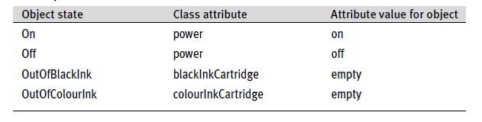
2. State
Determined by the attribute values of an object at a particular point in time
For example list of the states the printer can go through
You can see from this how an object’s state depends on the values of its attributes

Slide 6
3. Behavior
•
•
Operations in analysis, and as methods in design
Invoking an operation or method on an object will often cause a change in the values of one or more of its attributes, and this may constitute a state transition
A method is an implementation of an operation
This is a meaningful movement of the object from one state to another state
For example – there are certain things the printer can do for me:
switchOn()
switchOff( )
printDocument()
An operation is the specification of a piece of behavior. An implementation of that behavior is called a method
•
•
•
•

Slide 7
Encapsulation
Encapsulation, or data-hiding, is one of the primary benefits of OO programming
For example, if the balance is negative, then we may say that object is in the state overdrawn. As the balance changes from negative to zero, the object makes a significant change in its nature – it makes the state transition from the state overdrawn to the state empty and Account object’s balance becomes positive, it makes another state transition from the state empty to the state inCredit

Slide 8
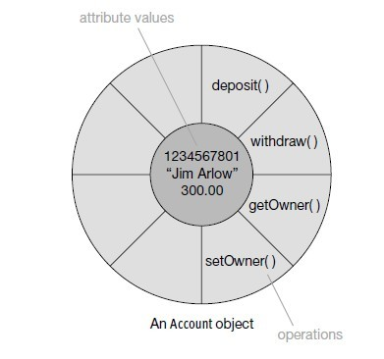
The behavior of any object is basically “what it can do” for us, and you can see that the object in Figure :

Slide 9
Messaging
Objects generate system behavior by sending messages to each other over links. This is collaboration
Objects collaborate to perform the functions of the system What this means is that objects form links to other objects and send messages back and forth along those links When an object receives a message, it looks at its set of operations to see if there is an operation whose signature matches the message signature

Slide 10
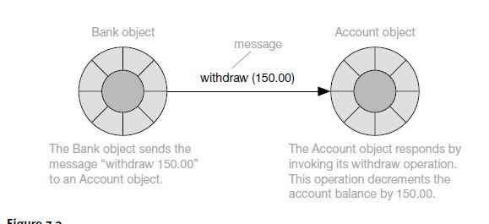
These signatures comprise the message (or operation) name, parameter types, and return value

Slide 11
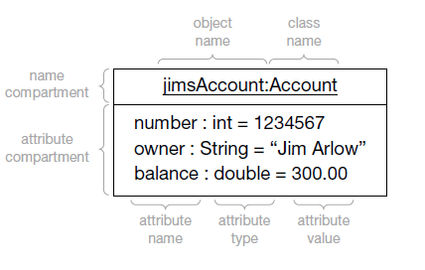
UML object notation
•
•
The UML object icon is a box with two compartments:
The top compartment contains the object identifier, which is always underlined
The underline- defines - whether a modeling element is a class or an object
•
•
Object

Slide 12
The object identifier can consist of any of the following:
The class name alone – e.g. :Account. This signifies that you have an anonymous object, or instance of that class
Anonymous objects are often used when there is only one object of a particular class on a given diagram
The object name alone – e.g. jimsAccount. This identifies a specific object but doesn’t identify which class it belongs to. This notation can be useful in very early analysis when you haven’t yet discovered all the classes
The object name concatenated with the class name, separated from each other by a colon. You may read the colon as, “is an instance of class”

Slide 13
Objects are usually named in mixed upper and lowercase, starting with a lowercase letter. Special characters, such as spaces and underscores, are avoided. This is known as lowerCamelCase
Attributes may be optionally shown in the lower compartment of the object icon. Those attributes that you choose to show must be named, and may have an optional type and value. Attributes are also named in CamelCase starting with a lowercase letter.
•
Object attribute values
→ Each object attribute value has the following form:
name : type = value
→ You may choose to show all, some, or none of the object attribute values, depending on the purpose of the diagram
→ To keep object diagrams simple and clear, you may choose to omit attribute types as they are already defined in the class of the object
•
•

Slide 14
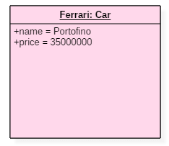
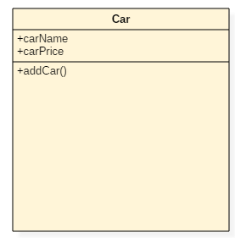
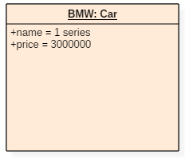

Slide 15
What are classes?
•
A class describes the features of a set of objects
•
A class defined as, “The descriptor for a set of objects that share the same attributes, operations, methods, relationships, and behavior”
•
Every object is an instance of exactly one class

Slide 16
Classes and objects
The relationship between a class and objects of that class is an «instantiate» relationship
The dotted arrow is actually a dependency relationship that has been given a special meaning by the stereotype
«instantiate»
Anything inside guillemots («…») is known as a stereotype, and stereotypes are one of the three UML extensibility mechanisms
A stereotype is a way of customizing modeling elements – a way of creating variants with new semantics. In this case, the stereotype «instantiate» turns an ordinary dependency into an instantiation relationship between a class and objects of that class
•
•
•

Slide 17
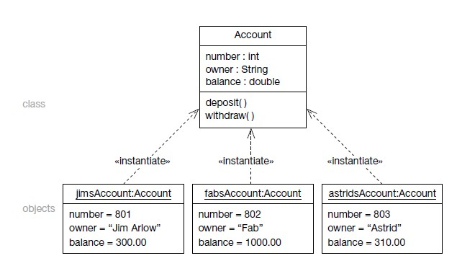

Slide 18
Class instantiation
Instantiation is the creation of new instances of model elements. In this case we are instantiating objects from classes – we are creating new instances of classes
In most OO programming languages, there are special operations, called constructors, which really belong to the class itself rather than the objects of that class
The purpose of constructor operations is to create new instances of the class
The constructor allocates memory for the new object, gives it a unique identity, and sets the initial attribute values for the object. It also sets any links to other objects
•
•
•

Slide 19
UML class notation
The visual UML syntax for a class is very rich, and to make it manageable it is important to apply the UML notation of optional adornments
The only mandatory part of the visual syntax is the name compartment with the class name in it
All the other compartments and adornments are optional

Slide 20
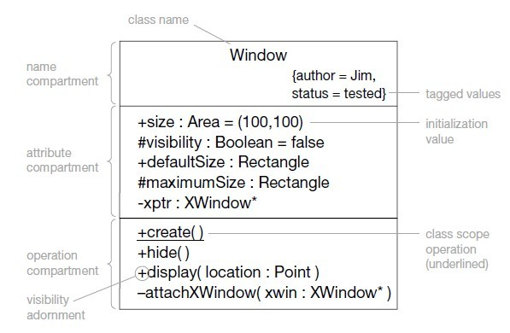
Syntax: with example

Slide 21
Name compartment
- naming convention for classes
1. Class name is in UpperCamelCase –
It begins with an uppercase letter, and then is in mixed upper and lowercase, with each word beginning in uppercase
Special symbols such as punctuation marks, dashes, underscores, ampersands, hashes, and slashes are always avoided
Including them in class names, or the names of any other modeling element for that matter, can lead to unexpected consequences when code or HTML/XML documentation is generated from the model
•
•
2. Avoid abbreviations at all costs
Class names should always reflect the names of real-world entities
without abbreviation
For example, FlightSegment is always preferable to FltSgmnt, DepositAccount is always preferable to DpstAccnt
•
3. If there are domain-specific acronyms (CRM- Customer Relationship Management) that are in common use and will be understood by all, then you may use them

Slide 22

Attribute compartment
The only mandatory part of the UML attribute syntax is the attribute name
      Visibility
      Type
      Multiplicity
      Initial Value
Advance attribute syntax :

Slide 23
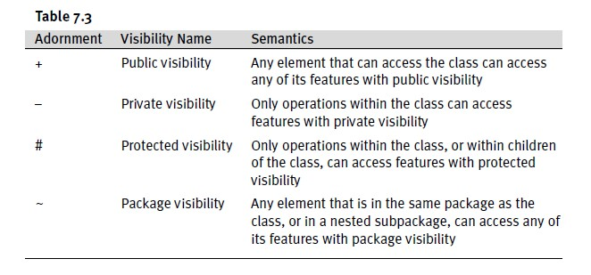
Visibility
Visibility controls access to the features of a class

Slide 24
Type
An attribute’s type may be another class or a primitive type
Primitive Type | Semantics
Integer | A whole number
UnlimitedNatural | A whole number >=0 Infinity is shown as *
Boolean | Can take the value true or false
String | A sequence of characters String literals are quoted, e.g. “Jim”

Slide 25
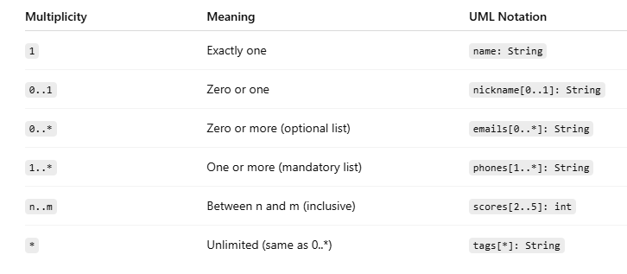
Multiplicity
Multiplicity defines how many instances of a type can be associated with a single attribute. It’s commonly used when an attribute represents a collection (array, list, set) rather than a single value.
How many objects of one class can be associated with an object of another class?

Slide 26
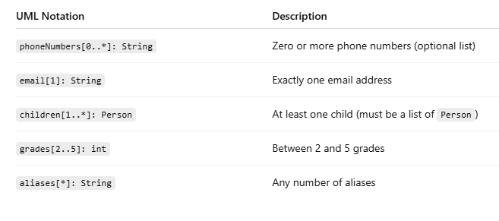
Example :
PersonDetails
name is composed of two or more Strings address is composed of three Strings emailAddress is composed of one String or null
-name : String [2..*]
-address : String [3]
-emailAddress : String [0..1]

Slide 27
Multiplicity
Collection
If the multiplicity expression results in an integer greater than 1, then you are specifying a collection of the type For example, colors : Color[7] - collection of seven color objects
•
Null values
When an attribute references null, this means that the object it points to has not yet been created or exist

Slide 28
Initial Value
The initial value allows you to set the value of an attribute at the point of object creation
Advance attribute syntax
You can also extend the specification of an attribute by postfixing the attribute with tagged values
for example,
Syntax:
«stereotype» attribute { tag1 = value1, tag2 = value2, …}
Example:
address {addedBy=“Jim Arlow”, date=“20MAR2001”}

Slide 29
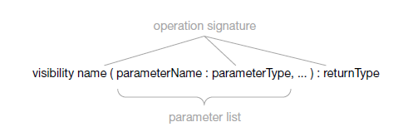
Operation Compartment
•
An operation signature comprises its name, the type of all its parameters, and its return type
Operations are functions that are bound to a particular class. As such, they have all of the characteristics of functions:
name
parameter list
return type
•
•
Syntax :

Slide 30
Parameter direction
Operation parameters can be given a direction
Syntax:
Operation(in p1:Integer, inout p2:Integer, out p3:Integer, return p4:Integer, return p5:Integer)
If the direction is not specified, then it defaults to in
For example maximumValue = max(a,b)
Normal UML operation : maximumValue(a:Integer, b:Integer):Integer
With parameter direction
maximumValue(in a:Integer, in b:Integer):Integer

Slide 31
Parameter | Semantics
in p1:Integer | Default The operation uses p1 as an input parameter P1 is not changed by the operation
inout p2:Integer | The operation accepts p2 as an input/output parameter P2 may be changed by the operation
out p3:Integer | The operation uses p3 as an output parameter P3 may be changed by the operation
return p4:Integer | The operation uses p4 as a return parameter The operation returns p4 as one of its return values
return p5:Integer | The operation uses p5 as a return parameter The operation returns p5 as one of its return values

Slide 32
Parameter default values
•
•
You can give an operation parameter a default value When the operation is called, if no value is given for that parameter, its default value will be used
Canvas
drawCircle(origin: Point = Point(0,0), radius:Integer) drawSquare(origin:Point = Point(0,0), size:Dimension)

Slide 33
Advanced operation syntax
You can extend the semantics of operations by prefixing them with stereotypes and postfixing them with tagged values
«stereotype» operation(…){ tag1 = value1, tag2 = value2, …}
Query operations -
Each operation has a property called isQuery
If you set this property to true in your modeling tool, the operation is a query operation
The default value for isQuery is false
Example
«query» getBalance() : Double { isQuery=true }
BankAccount
balance: double
Query operation
getBalance() : double

Slide 34
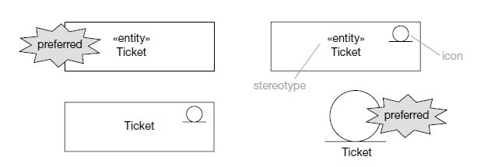
Class stereotype syntax
There is a lot of flexibility in how stereotypes can be displayed
However, most modellers just use the name in guillemots («stereotypeName») or the icon
•

Slide 35
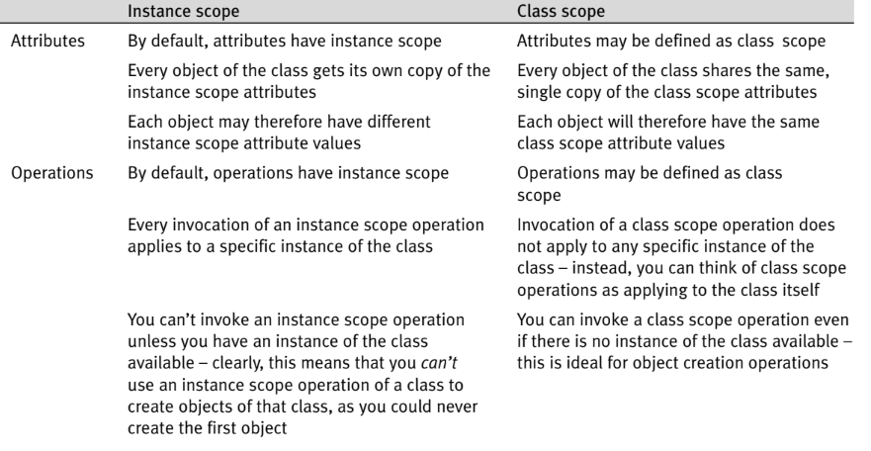
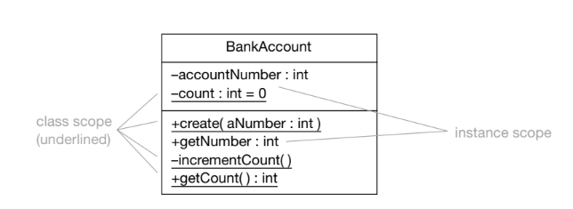
Instance scope and class scope

Slide 36
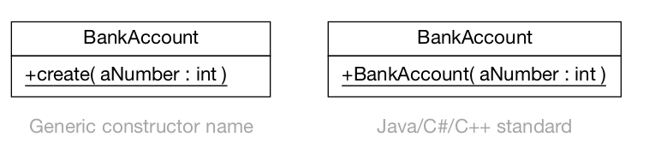
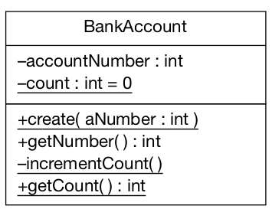
Object construction and destruction
Constructors : Constructors are special methods used to create and initialize objects of a class.
They have class scope, because you need to call them even before an object exists.
Destructor : Destructors are special methods used to clean up resources when an object is destroyed.

Slide 37
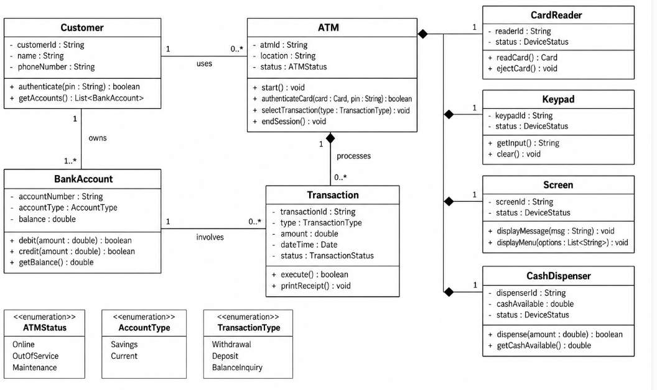
Example - ATM

Slide 38
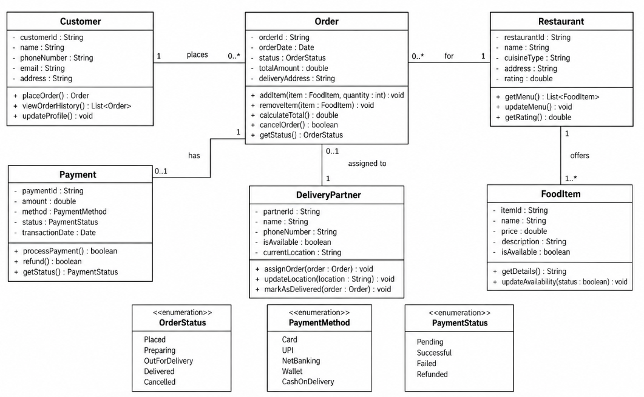
Example - Online Food Delivery

Slide 39
THANK YOU

